Slide 1
Mobile Application Development
Input Controls

Slide 2
Input controls
Input controls are the interactive components in application user interface.
Android provides a wide variety of controls that can be used in the user interface:

Slide 3
Common Controls
Pickers
webView
MapView
Autocomplete
Spinner
Button
TextField
Radio Button
Checkbox
Toggle button

Slide 4
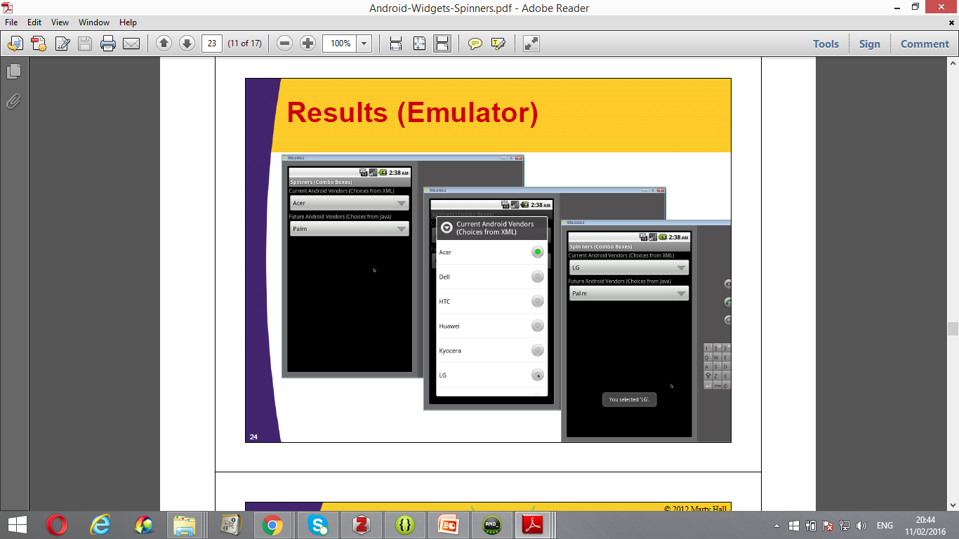
Spinners
Spinners provide a quick way to select one value from a set.
In the default state, a spinner shows its currently selected value.
Touching the spinner displays a dropdown menu with all other available values, from which the user can select a new one.

Slide 5
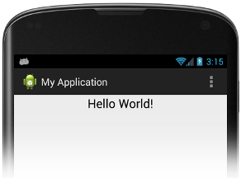
TextView
This control is used to display text to the user.
Although it contains text editing operations, the basic class does not allow editing

Slide 6
Text View
It is described using the following attributes
android:id- This is the ID which uniquely identifies the control.
android:textColor – Specifies the color of the text . The color should be defined in hexadecimal encoding e.g. "#rgb", "#argb", "#rrggbb", or "#aarrggbb". or as a reference to another resource. e.g. “@color/blue”
Android:background- sets the background color of the text. Again the color should be defined in hex encoding or as a reference to another resource.

Slide 7
TextView
Layout_Width: The width of the textfield e.g. Match parent
Layout_Height: The height of the textField e.g. Wrap_content
android:gravity - Specifies how to align the text by the view's x- and/or y-axis when the text is smaller than the view.
android:text - Specifies text to display.
android:textSize - specifies size of the text. E.g.“ 15 sp“ which means “15 scaled-pixels
Android: fontFamily- specifies the font family for the text. e.g. Arial
Android:textStyle - specifies font style e.g. “bold”

Slide 8
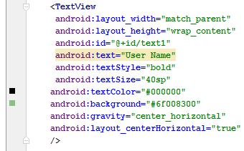
TextView
Example:

Slide 9
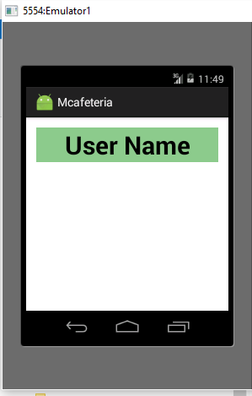
TextView: Example
The application prints the following output, once it is executed:

Slide 10
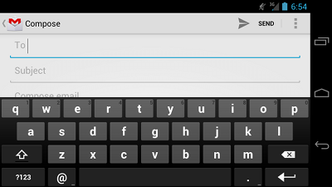
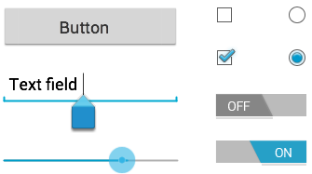
Text Field
A text field allows the user to type text into the application. It can be either single line or multi-line.
Touching a text field places the cursor and automatically displays the keyboard.
It also allows for a variety of other activities, such as text selection when cutting , copying and paste text.

Slide 11
Text Field: syntax
<EditText
xmlns: Attribute=“value”
xmlns: Attribute=“value”
............................
............................
/>

Slide 12
Text Field: Attributes
Id: The identifier of the textField.
Layout_Width: The width of the textfield
Layout_Height: The height of the textField
Hint: Text that will act as a hint to the user
inputType: Type of values to be entered by the user

Slide 13
Text Field: Attributes
Examples of InputType values:
“text“ : Normal text Keyboard.
"textEmailAddress“: Normal text keyboard with the @ character.
"textUri“ : Normal text keyboard with the / character.
"number“: Basic number keypad.
"phone“ : Phone-style keypad.

Slide 14
Text Field: Example
<EditText android:id="@+id/email_address" android:layout_width=“match_parent" android:layout_height="wrap_content" android:hint="@string/email_hint" android:inputType="textEmailAddress" />
Explanation
The id of the textField is “email_address” , The width is equal to the width of the parent, height encloses its contents,
email_hint will be provided to the user, and
Normal text will be entered with ‘@’ character

Slide 15
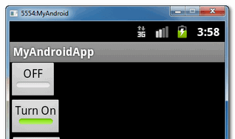
Toggle Button
A toggle button allows the user to change a setting between two states.
It’s best alternative to radio buttons to turn on or turn off a function.

Slide 16
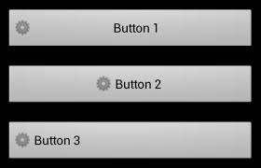
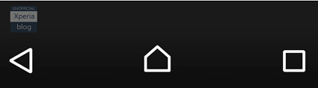
Push Button
Push-button is an input control that can be pressed, or clicked, by the user to perform an action.
It consists of text or an icon (or both text and an icon) that communicates what action occurs when the user touches it.

Slide 17
Push Button
Push-button is an input control that can be pressed, or clicked, by the user to perform an action.
It consists of text or an icon (or both text and an icon) that communicates what action occurs when the user touches it.

Slide 18
Push Button attributes
<Button android:layout_width="wrap_content" android:layout_height=“match_Parent" android:text="@string/button_text" ... />
match_parent : Specifies that the view should be as big as its parent.
wrap_content: the view should be just big enough to enclose its content
@string/button_text: The caption of the button contains text from button_text ID which is defined at string attribute

Slide 19
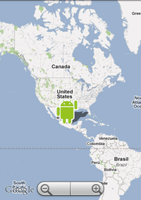
MapView
A MapView displays a map with data obtained from the Google Maps service.
It used to capture key presses and touch gestures to pan and zoom the map automatically.
It also provides all of the UI elements controlling the map.

Slide 20
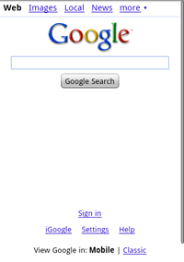
WebView
The WebView is used to display web pages as a part of current activity layout.
It does not include any features of a fully developed web browser, such as navigation controls or an address bar.
It can be used to provide information that might need to update, such as an end-user agreement
Can also be used provides data to the user that always requires an Internet, such as email.

Slide 21
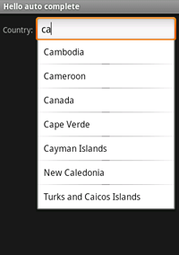
Auto Complete
An editable text view that shows completion suggestions automatically while the user is typing.
The list of suggestions is displayed in a drop down menu from which the user can choose an item to replace the content of the edit box with.
The drop down can be dismissed at any time by pressing the back key or, if no item is selected in the drop down, by pressing the enter/dpad center key.
The list of suggestions is obtained from a data adapter and appears only after a given number of characters defined by the threshold.

Slide 22
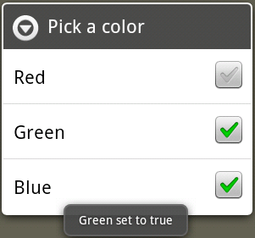
CheckBox
CheckBox is an on/off switch that can be toggled by the user.
It used when presenting users with a group of selectable options that are not mutually exclusive.

Slide 23
Creating CheckBox : Syntax
Checkbox is defined using the following xml syntax
<CheckBox
xmlns: Attribute=“value”
xmlns: Attribute=“value”
............................
............................
/>

Slide 24
Creating CheckBox: Example
<CheckBox
android:id="@+id/checkbox_meat" android:layout_width="wrap_content" android:layout_height="wrap_content" android:text="@string/meat" android:onClick="onCheckboxClicked“ />
Explanation:
Identifier of the checkbox is checkbox_meat,
Both height and width encloses the content
The caption of the checkbox contains text that is at string element and defined by meat attribute.
The checkbox will be invoked by onCheckboxClicked() Methods

Slide 25
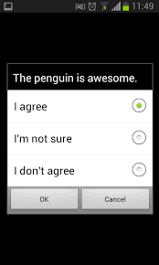

Radio Button
Radio buttons allow the user to select one option from a set.
They are used for optional sets that are mutually exclusive and when the user needs to see all available options side-by-side.

Slide 26
Creating Radio Button
Radio buttons are created using layout.xml files using the following syntax:
However, because radio buttons are mutually exclusive, they must be grouped together inside a RadioGroup.
By grouping them together, the system ensures that only one radio button can be selected at a time.

Slide 27
Creating Radio Button : Syntax
<RadioGroup xmlns:android="http://schemas.android.com/apk/res/android" android:layout_width="fill_parent" android:layout_height="wrap_content" android:orientation="vertical"> <RadioButton xmlns: Attribute=“value”
xmlns: Attribute=“value”
..........................
xmlns: onClickAttribute=“method name” "/> <RadioButton
xmlns: Attribute=“value”
xmlns: Attribute=“value”
............................ .
xmlns: onClickAttribute=“method name” "/> </RadioGroup>

Slide 28
Creating Radio Button: Onclick attribute
android:onClick attribute is used to define the click event handler for radio button.
The attribute is defined in XML layout at <RadioButton> element .
The value for android:onClick attribute must be the name of the method defined in Java code file.
The method will be called in response to a click event

Slide 29
Creating Radio Button: XML code Example
<?xml version="1.0" encoding="utf-8"?> <RadioGroup xmlns:android="http://schemas.android.com/apk/res/android" android:layout_width="fill_parent" android:layout_height="wrap_content" android:orientation="vertical"> <RadioButton android:id="@+id/RdioMale" android:layout_width="wrap_content" android:layout_height="wrap_content" android:text="@string/MGender" android:onClick="onRadioButtonClicked"/> <RadioButton android:id="@+id/RadioFemale" android:layout_width="wrap_content" android:layout_height="wrap_content" android:text="@string/FGender" android:onClick="onRadioButtonClicked"/> </RadioGroup>

Slide 30
Creating Radio Buttons: Strings.XML code Example
<resources> <string name="app_name">RadioButtonsExample</string> <string name="MGender">Male</string> <string name="FGender">Female</string> <string name="action_settings">Settings</string> </resources>
This code defines two string values.
Mgender value for referencing ‘Male’ string.
Fgender value for referencing ‘Female’ string.

Slide 31
Creating Radio Buttons: XML code Example
Explanation
android:id="@+id/RdioMale“ : The identifier of radio button
android:layout_width="wrap_content“ :The width= button’s content
android:layout_height="wrap_content“ :The height=button’s content
android:text="@string/MGender“ :Caption=content of Mgender value
android:onClick="onRadioButtonClicked"/> : Button will respond
when onRadioButtonClicked Method is called

Slide 32
Handling Radio Buttons
In order to allow interaction, the Activity hosting the layout.xml file must implement the corresponding method.
The method is used to handle the click event for both radio buttons:

Slide 33
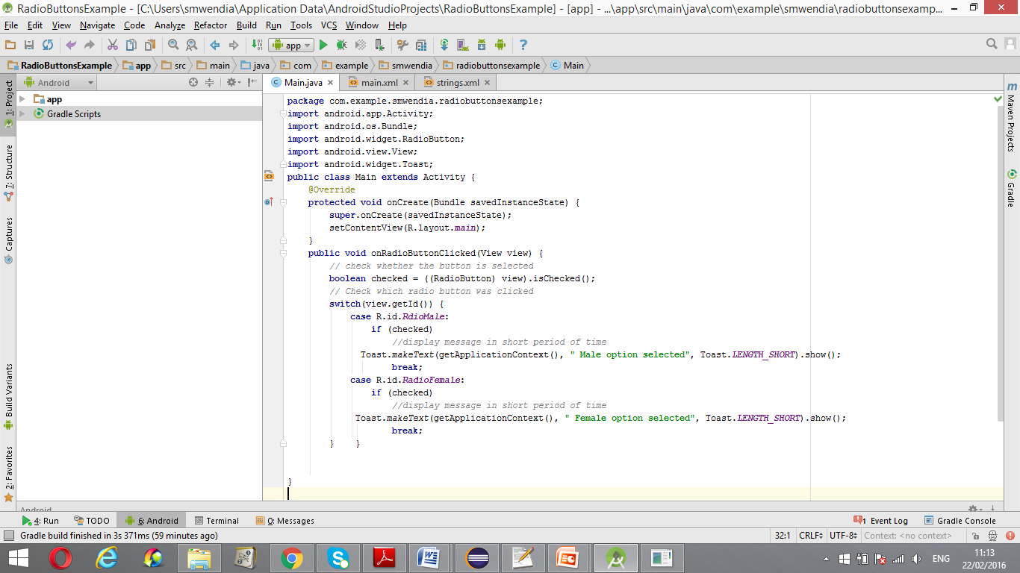
Handling Radio Button: Example
For example, onRadioButtonClicked() which is named in xml file can be used to handle both radio Buttons as follows:

Slide 34
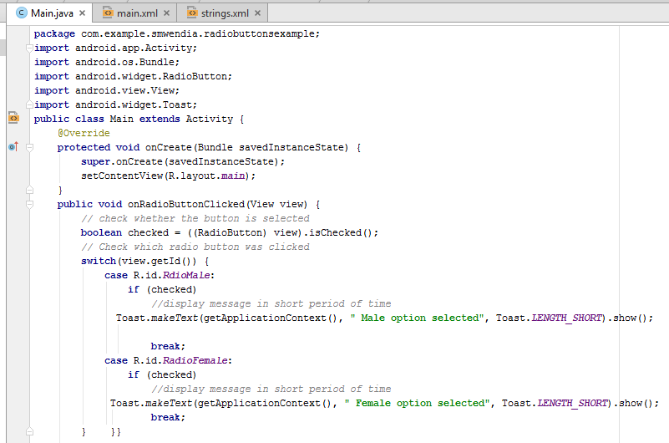
Handling Radio Button: complete Java code Example

Slide 35
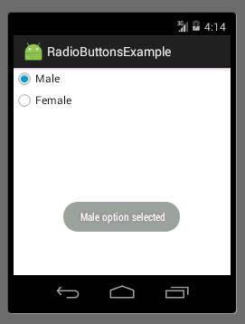
Radio Buttons: Running application
When the application is executed, it displays the following interface

Slide 36
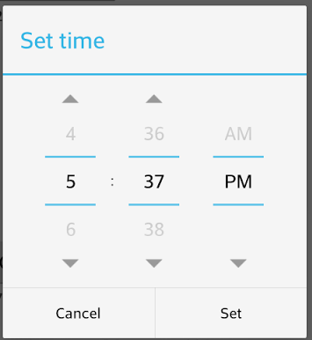
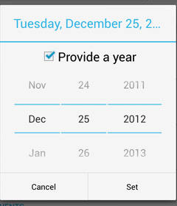
Picker
Picker is a user interface control that allows the user to pick ready-to-use dialogs.
Pickers helps to ensure that users can pick only those values that are valid, formatted correctly, and adjusted to the user's locale.
Time Picker
Date Picker

Slide 37
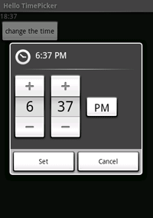
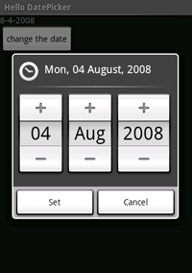
Types of Pickers
There are two main types:
Time Picker: provides controls that allows the user to select parts of time (hour, minute, AM/PM)
Date Picker: Provides the user with controls for selecting part of date month, day, year).
Time Picker
Date Picker

Slide 38
Creating a Time picker
A time Picker is created by defining a fragment class for displaying a TimePickerDialog using DialogFragment,
The fragment class extends DialogFragment and return TimePickerDialog from the fragment's onCreateDialog() method.

Slide 39
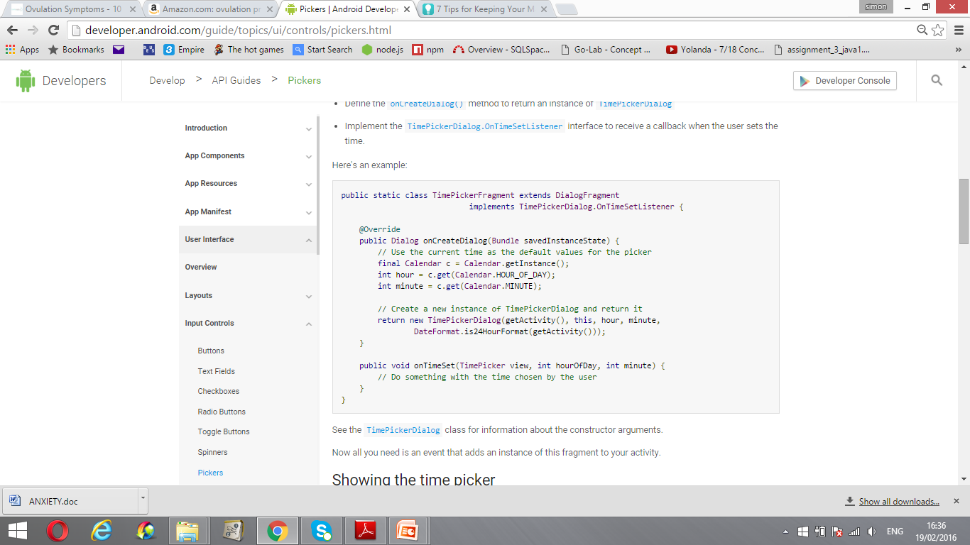
Creating a Time Picker: Example

Slide 40
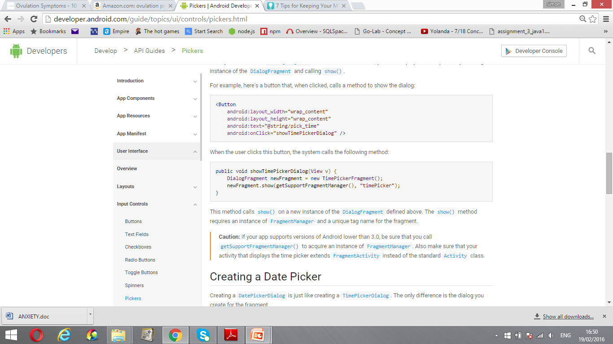
Showing Time Picker
The time picker is displayed by creating an instance of the DialogFragment and calling show().
For example, here's a button that, when clicked, calls a method to show the dialog:
<Button android:layout_width="wrap_content" android:layout_height="wrap_content" android:text="@string/pick_time" android:onClick="showTimePickerDialog" />
When the user clicks the above button, the system calls the following method:

Slide 41
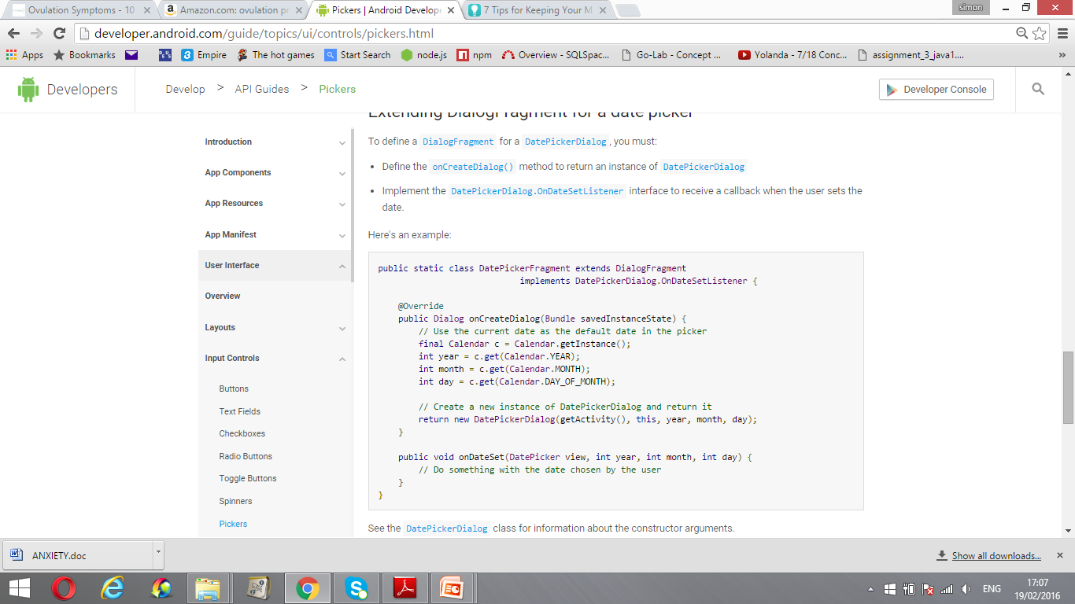
Creating a Date Picker
Creating a Date picker involves creating a fragment class that extends DialogFragment class and returns a DatePickerDialog from that fragment's onCreateDialog() method. For example:

Slide 42
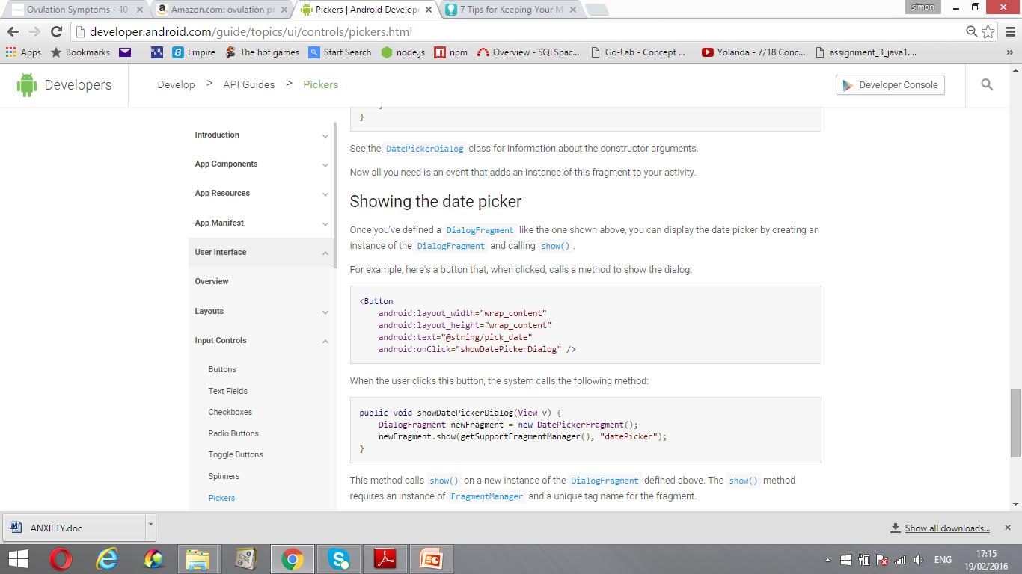
Showing the date picker
Date picker can be displayed by creating an instance of the DialogFragment and calling show() method using a button.
Example:
<Button android:layout_width="wrap_content" android:layout_height="wrap_content" android:text="@string/pick_date" android:onClick="showDatePickerDialog“ />
When the user clicks the above button, the system calls the following method:

Slide 43


Thank you!!

